Slide 1
Apple Stock Price Prediction
Group 5 :-
Mentor – Sadiya Ma’am
Jagdish Kollur
Moulika Uppala
Nehal Kakade
Jaswanth Singireddy
Vrushabh Jain
Supriya Dandolu
Shruti Bhosale

Slide 2
Problem Statement
Stock price forecasting is challenging due to volatility
Need for interpretable and reliable forecasting system.
Make informed decisions based on stock trends and potential market movements.

Slide 3
Objectives
Develop a time series forecasting model to predict Apple’s stock price for the next 30 days.
Analyse short-term and long-term trends in stock prices.
Explore the impact of external events (e.g., earnings reports, macroeconomic events, global financial crises) on Apple’s stock.
Evaluate different machine learning models such as ARIMA, SARIMA, and XGBoost for accurate
Visualize trends, seasonality, and volatility in Apple’s stock prices.
Deploy the final forecasting model using a Flask/Streamlit web app to allow real-time predictions

Slide 4
Dataset Description
Apple stock historical data
Time range: 2012 – 2019
Key column: Adjusted Close Price
Size: Rows = 2011 , columns = 7

Slide 5
Feature Engineering
Moving Averages (7, 21, 50 days)
Stocks often exhibit momentum; short-term price fluctuations may be noisy, but moving averages smooth them.
They help the model distinguish temporary spikes from sustained trends.
Market Trend (30-day mean)
Captures the overall direction of the stock over a month.
Helps the model differentiate between normal fluctuations and actual upward/downward trends.
Volatility indicators
Volatility indicates periods of higher or lower risk, which affects price movement.
Financial markets are inherently volatile.

Slide 6
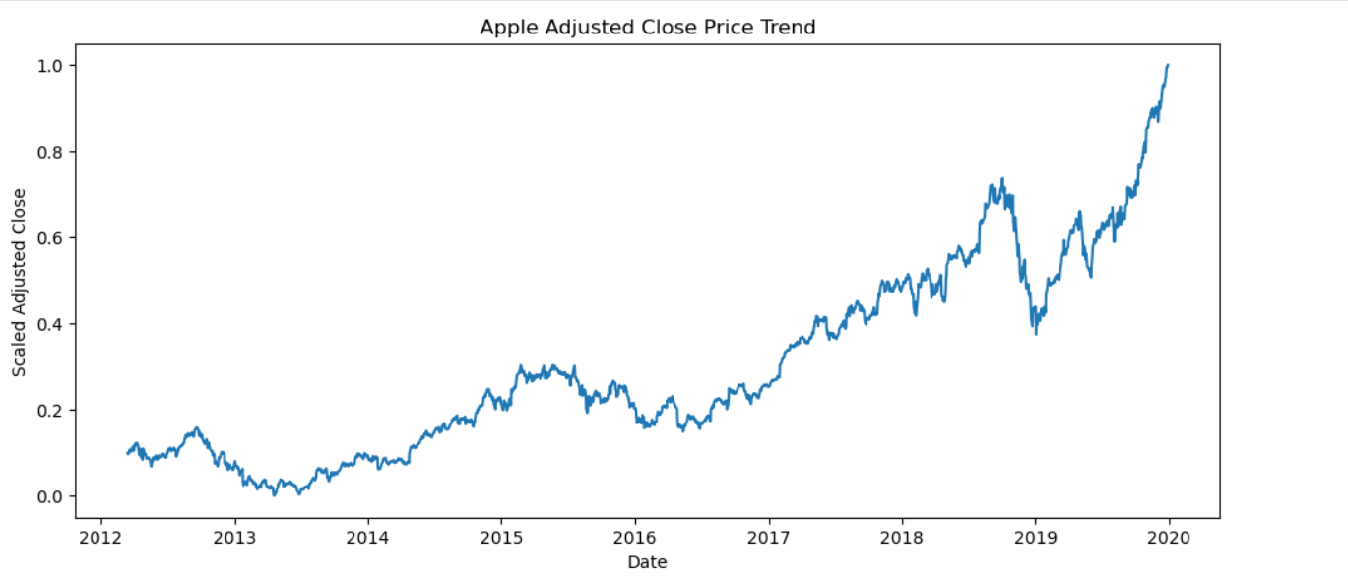
Exploratory Data Analysis(EDA)
Trend Plot
The target variable shows a general upward trend over the years with short-term fluctuations.
Occasional dips correspond to market corrections or high volatility periods.

Slide 7
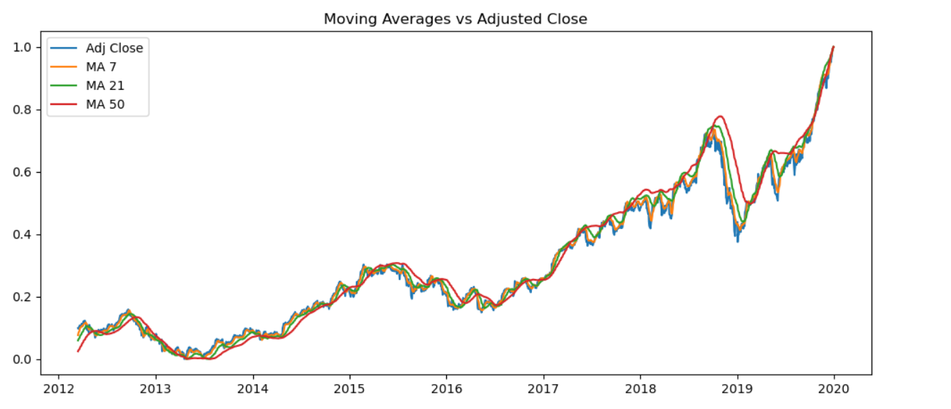
Exploratory Data Analysis(EDA)
MA vs Adj Close Plot
MA_21 smooths the mid-term trend → filters out daily noise.
MA_50 highlights long-term trend → shows sustained directional movement.
MA_7 reacts quickly to price changes → captures short-term momentum.

Slide 8
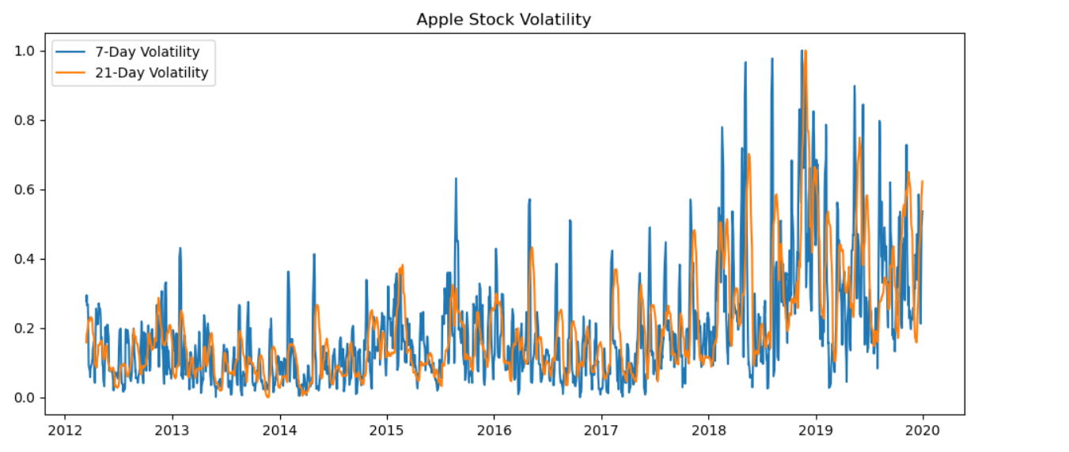
Exploratory Data Analysis(EDA)
Volatility Plot
Volatility_7 captures short-term fluctuations.
Volatility_21 shows longer-term risk exposure.
Volatility spikes occur during periods of sharp price changes.

Slide 9
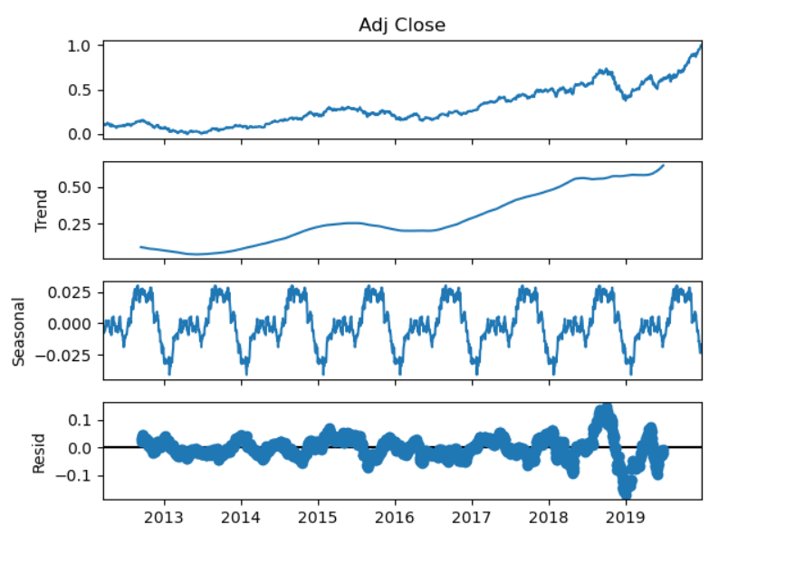
Exploratory Data Analysis(EDA)
Seasonal Decompose Plot
Seasonal component captures recurring patterns (e.g., weekly/monthly cycles).
Residual component represents irregular fluctuations (noise) not explained by trend or seasonality.
Trend component aligns with overall upward movement in the stock.

Slide 10
Models Implemented
ARIMA
Autoregressive Integrated Moving Average.
It predicts future values using past values and trends.
ARIMAX
ARIMA with eXogenous variables.
It incorporates external features to improve forecasting accuracy.
SARIMA
Seasonal ARIMA.
It extends ARIMA by modelling seasonality in time series data.
Prophet
Facebook’s forecasting tool.
It handles trend, seasonality, and holidays automatically.
Gradient Boosting
Ensemble of weak learners combined sequentially to reduce prediction errors.
XGBoost
Optimized gradient boosting.
It is fast, regularized, and often performs well on tabular data.
SVR(Support Vector Regressor)
Finds a function within a margin of tolerance.
It is effective for small datasets and non-linear trends.
Random Forest
Ensemble of decision trees.
It averages predictions to reduce overfitting and improve stability.

Slide 11
Model Evaluation
ARIMAX performed best
It showed RMSE of 0.018, ranking lowest among all other.
Stable forecasts
It showed minimum gaps in CI levels.
Incorporates external features
It includes additional variables like moving averages or volatility to improve accuracy.
Interpretable coefficients
Each parameter has a clear meaning, allowing insight into the effect of past values and exogenous variables.
Handles non-stationarity
Differencing in ARIMAX makes it suitable for time series with trends or changing variance.
Suitable for financial time series
Designed for data with trends, cycles, and external factors typical in financial markets.

Slide 12
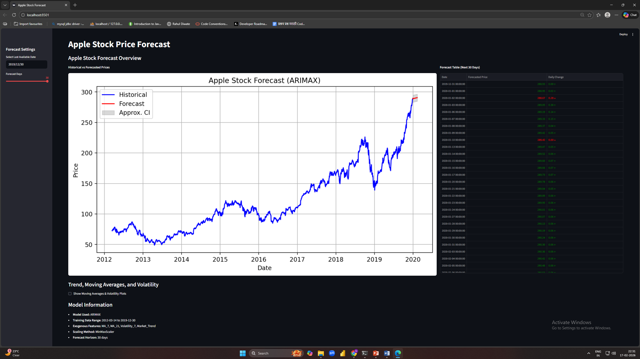
Web App Deployment
Table Output
User Input
Graphical Output
More Plots
Information about model

Slide 13
Dynamic UI Features
Date selection
Users can select any date from historical data as well as 30 days after date.
Dynamic plots
Plots change upon user input making UI more dynamic and readable.
Forecast horizon control
The future date can be selected from day 1 to day 30 through slide bar.
Responsive tables
The table shows red color for downtrend and green for uptrend making it more dynamic and informative.

Slide 14
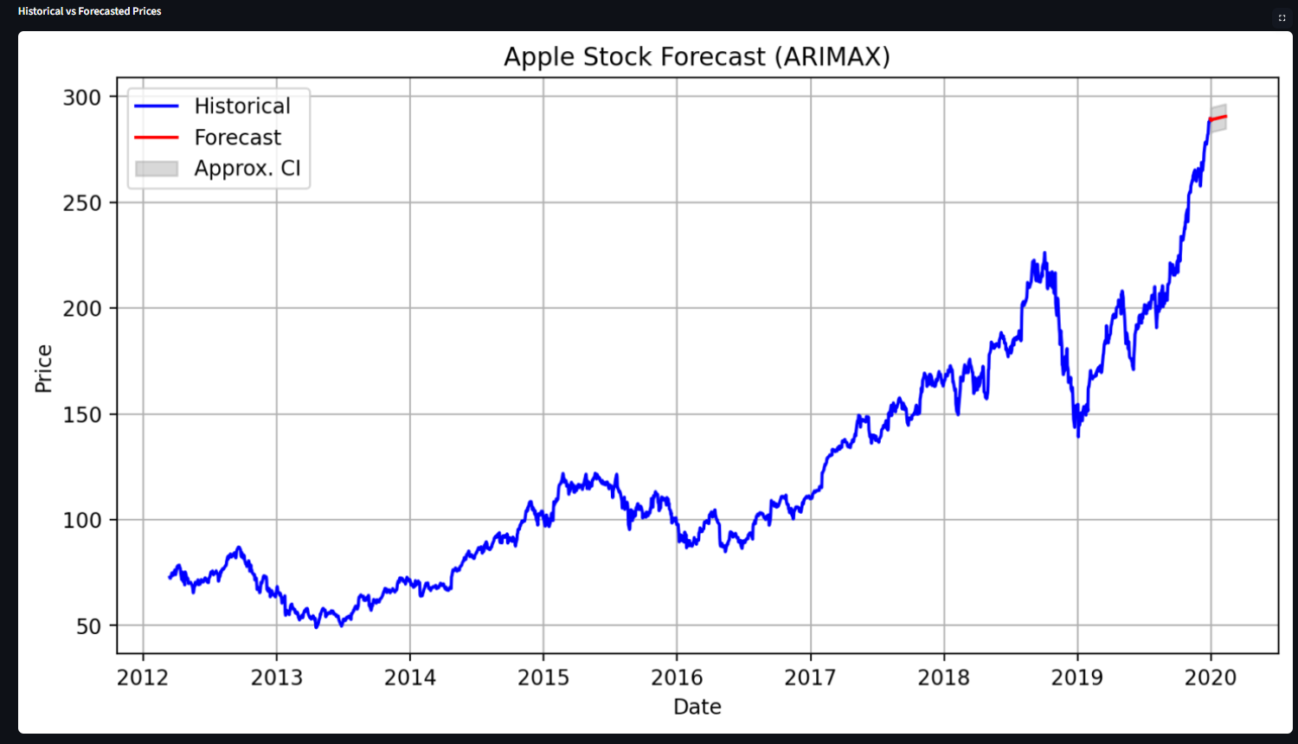
Visualization in Deployed App
Forecast Plot
The forecast line shows a general upward trend over the 30 days time period.
The model successfully finds the trend and the price variation for next 30 days.

Slide 15
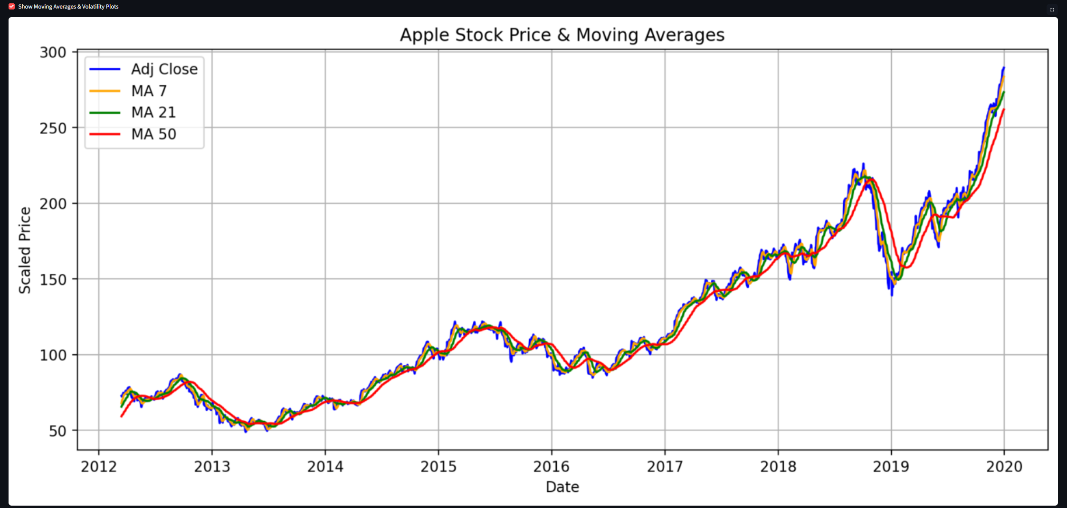
Visualization in Deployed App
MA vs Adj Close Plot
The target variable follows closely with MA_7 and fluctuates a little with MA_50.
It indicates ARIMAX model successfully identifies the variations in prices over time.

Slide 16
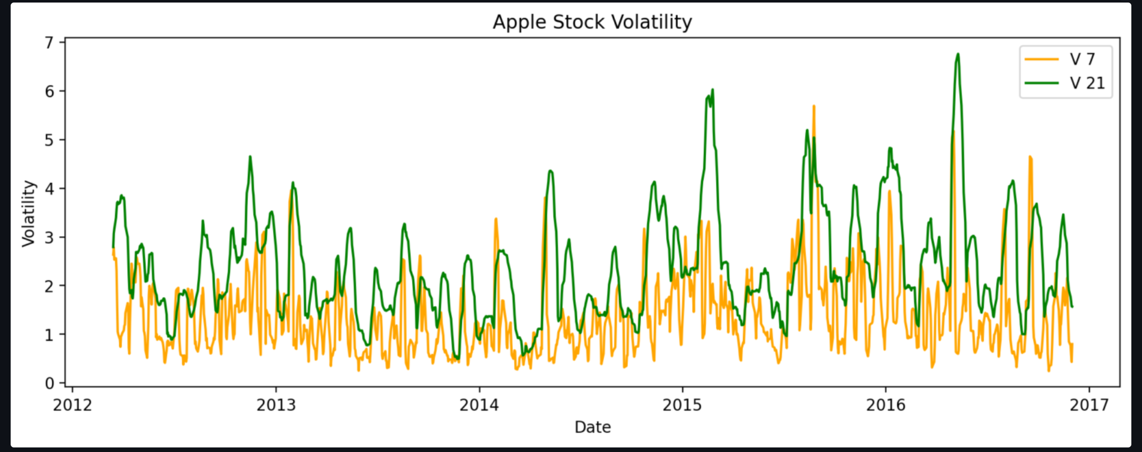
Visualization in Deployed App
Volatility Plot
The apple stock shows a lot of fluctuation over years of time period.
It indicates that this type of data requires time series model to properly capture trend without causing major spikes and ARIMAX is that model.

Slide 17
Challenges And Solutions
Challenge 1: Non-Stationary Stock Data
Solution: Applied differencing and used ARIMAX which handles non-stationarity effectively.
Challenge 2: Model Overfitting in ML Models
Solution: Compared multiple models and selected ARIMAX for stable forecasts.
Challenge 3: Selecting Meaningful Features
Solution: Used domain-relevant indicators like Moving Averages and Volatility.
Challenge 4: Static Plots in Initial UI
Solution: Implemented dynamic filtering based on selected date to update plots and forecasts.
Challenge 5: Deployment Compatibility Issues
Solution: Saved trained model and scalers separately to ensure consistent predictions in Streamlit app.

Slide 18
Conclusion
Successfully built forecasting system
ARIMAX proved effective
UI makes model practical and usable
Visualizations enhance understanding
Handles noisy financial data
Dynamic and interactive UI

Slide 19
Thank You

